Slide 1
Neurodrone-X
Revolutionizing Agriculture and Waste Management
Smart Skies. Clean Earth

Slide 2
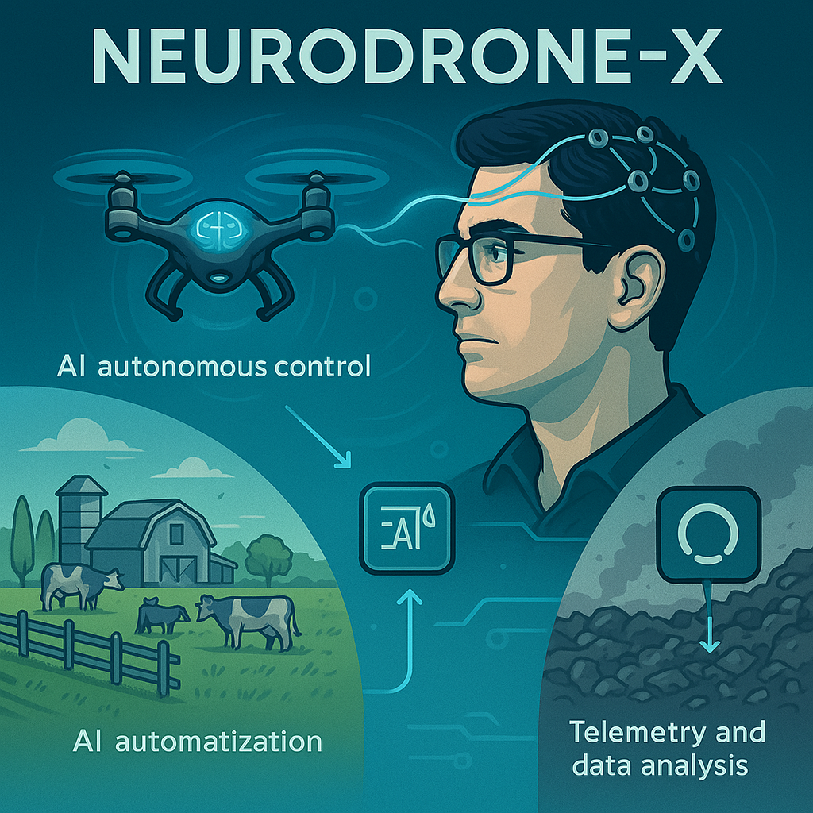
Introduction
NeuroDrone-X – Redefining Autonomy in Agriculture & Waste Tech
Welcome to the age where a single drone does it all. NeuroDrone-X is an AI-powered, voice-controlled, multi-mission drone system built to automate dirty work—from monitoring farmlands to handling urban waste, and everything in between.
Equipped with advanced edge computing, real-time object detection, voice recognition, and smart bin integration, NeuroDrone-X doesn't just fly—it thinks. Farmers can command it by voice to test soil, scan crops, or detect pests. City waste bins can signal it autonomously to pick up garbage.
This isn’t just drone tech—it’s an intelligent ecosystem designed to save time, cut costs, and reduce human effort. All while keeping the environment cleaner and agriculture smarter.

Slide 3
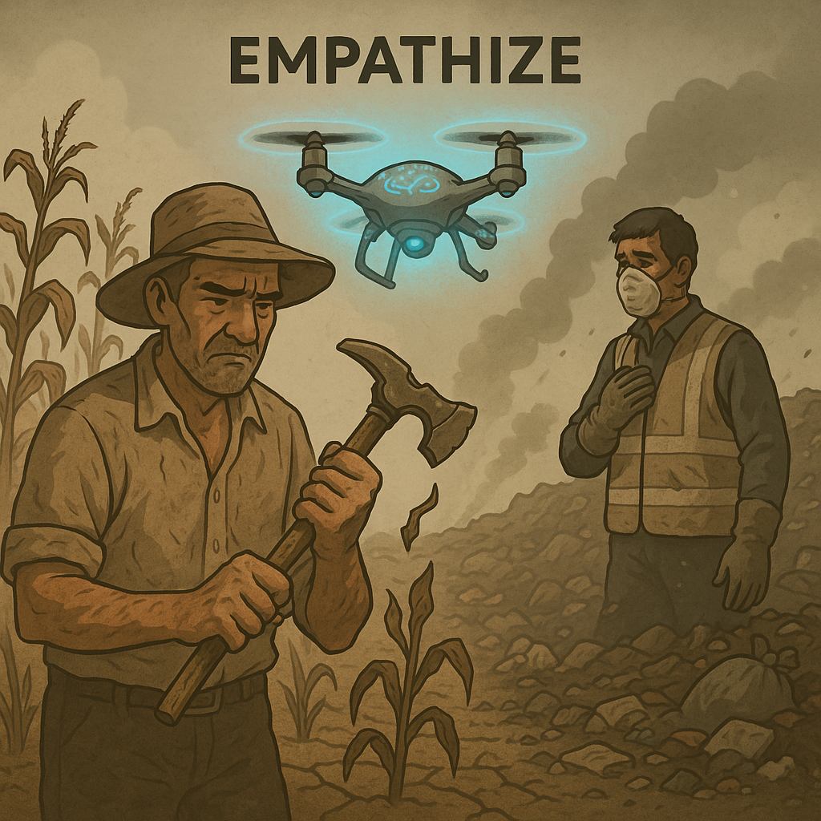
Empathize: What’s Broken in the Real World?
Agriculture:
70% of farms face labor shortages every season
Farmers still rely on manual crop checks The next-gen workforce isn't interested in hard, outdoor labor
Current drones just record video — they don’t help solve real problems
Waste Management
Landfills and dump sites are often toxic and unsafe to inspect manually
There's no efficient way to monitor large or illegal dump zones
Drones exist, but most require manual operation — not scalable, not safe
🎯 Goal of This System:
Use your brain to fly drones — no hands needed. Great for planting, spraying crops, or watching over animals, especially in tough or remote areas.
Control drones with your mind to check out landfills or dangerous waste zones — no need to go in yourself.

Slide 4
JOURNEY MAP
Test Case | Description | Expected Result
Smart Bin Trigger | Full bin sends alert | Drone launches within 5–10 seconds
Vision Alignment | Drone aligns over bin | Within ±15 cm accuracy
Pickup & Drop | Drone grabs and dumps waste | No manual input, 1-cycle success
Auto-Return | Drone lands on pad or dock | Accurate landing, logs mission
Voice Command | "Scan Zone B" or "Return to base" | Drone responds correctly within 3 seconds

Slide 5
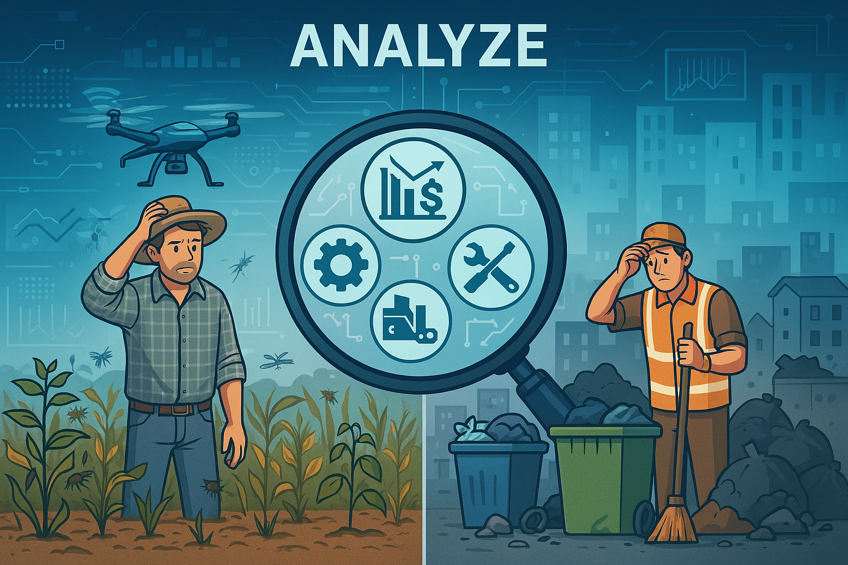
Analyze: What Are the Core Problems to Solve?
Pain Points :
Lack of Real-Time Insights — People are making critical decisions blind.
Inefficient Manual Labor — Slow, error-prone, and aging workforce.
Fragmented Tech — Drones for surveillance, IoT for sensors, AI for analysis—why are these all separate still?
Scalability & Cost — Farmers and municipalities can’t burn cash on five different devices when one should do the job.
🎯 Goal of This System:
If Empathize is understanding what hurts, then Analyze is figuring out why it still hurts despite all the tech that already exists.

Slide 6
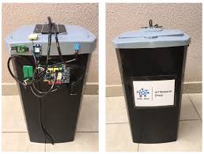
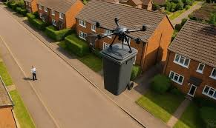
Ideate: Now Let’s Cook. What’s Neurodrone-X?
Neurodrone-X = One Drone to Rule Them All:
A self-learning AI drone system that monitors, analyzes, and manages both farmlands and urban waste zones in real-time.
Intelligent Features:
1. Smart Bin Integration:
Auto-launch when smart bins report full status
Drone navigates, collects waste, dumps at disposal site Returns to launchpad with no human control required
Optimized routes and payload awareness using AI
2. Voice-Controlled Farming Assistance:
Farmers can assign tasks via voice: “Neurodrone-X, scan the north field” or “Spray Zone 3 with pesticide”
Natural Language Processing understands local dialects and custom commands
Boosts accessibility for non-tech-savvy users

Slide 7
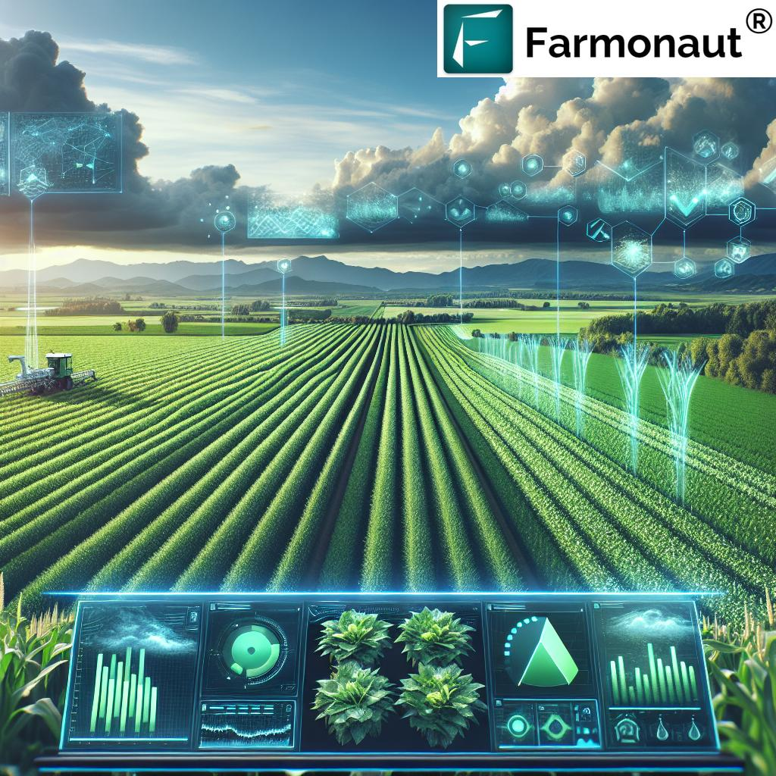
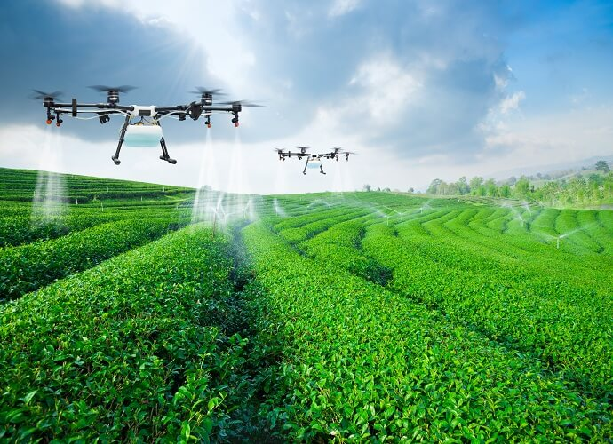
3. Advanced AI Backbone:
Reinforcement learning for smarter navigation and task optimization
Predictive maintenance alerts
Adaptive task scheduling based on weather, soil, and crop data
Summary for Ideate:
“Neurodrone-X responds autonomously to smart bin alerts, collects waste using a robotic payload system, navigates to the disposal zone, completes the dump, and returns—all with no human involvement.”
🎯 Goal of This System:
The Ideate stage’s goal is to create the blueprint for your Neurodrone-X—what it is, how it works, and why it’s better than anything out there.

Slide 8
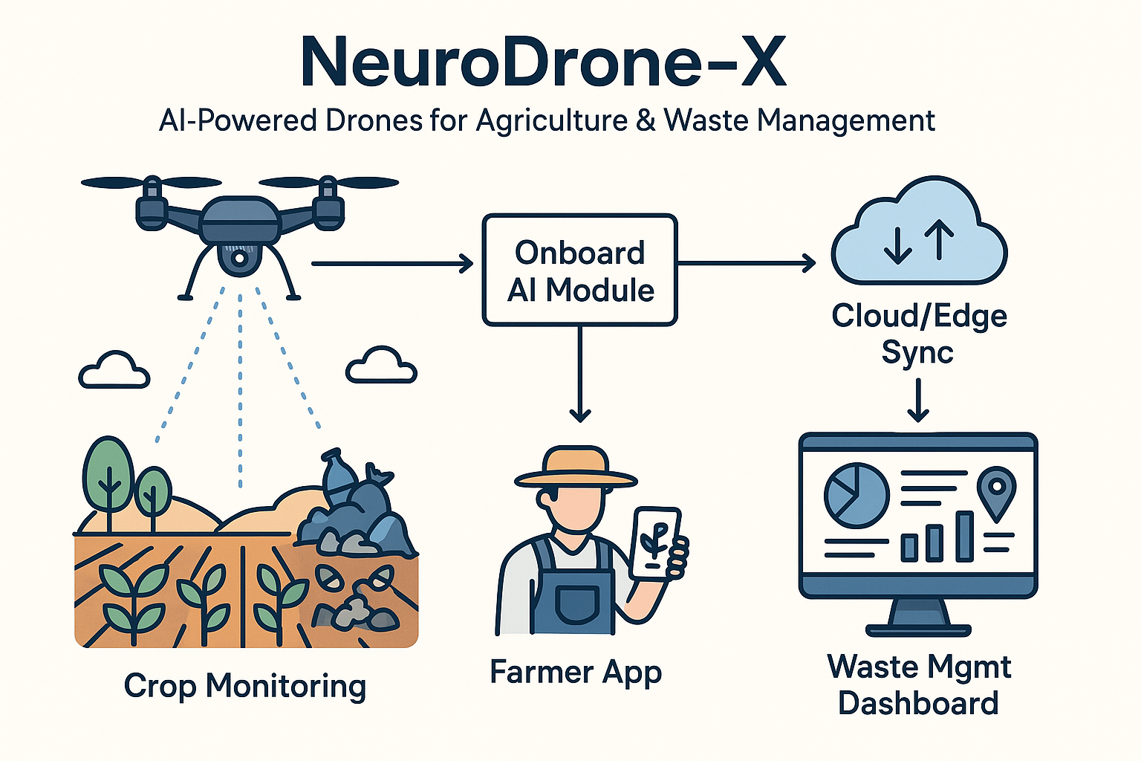
Prototype: Build It Fast, Break It Smart
Hardware:
Drone: DJI Matrice or custom quadcopter with payload support
AI Module: Jetson Nano or TX2 for real-time onboard processing
Tools: Grabber arm or magnetic clamp for waste pickup
Sensors: GPS + RTK, LiDAR, and camera for navigation and vision
Smart Bin: Uses ultrasonic sensor + ESP32 to send "bin full" alerts
Software:
Vision AI: YOLOv8 for detecting waste and objects
Voice AI: Whisper for speech-to-text
NLP: DistilBERT or custom model to understand commands
Control: Python + DroneKit/ROS for drone tasks
Communication: MQTT/WebSocket for real-time bin-drone link
UI: FastAPI dashboard for monitoring and mission logs.

Slide 9
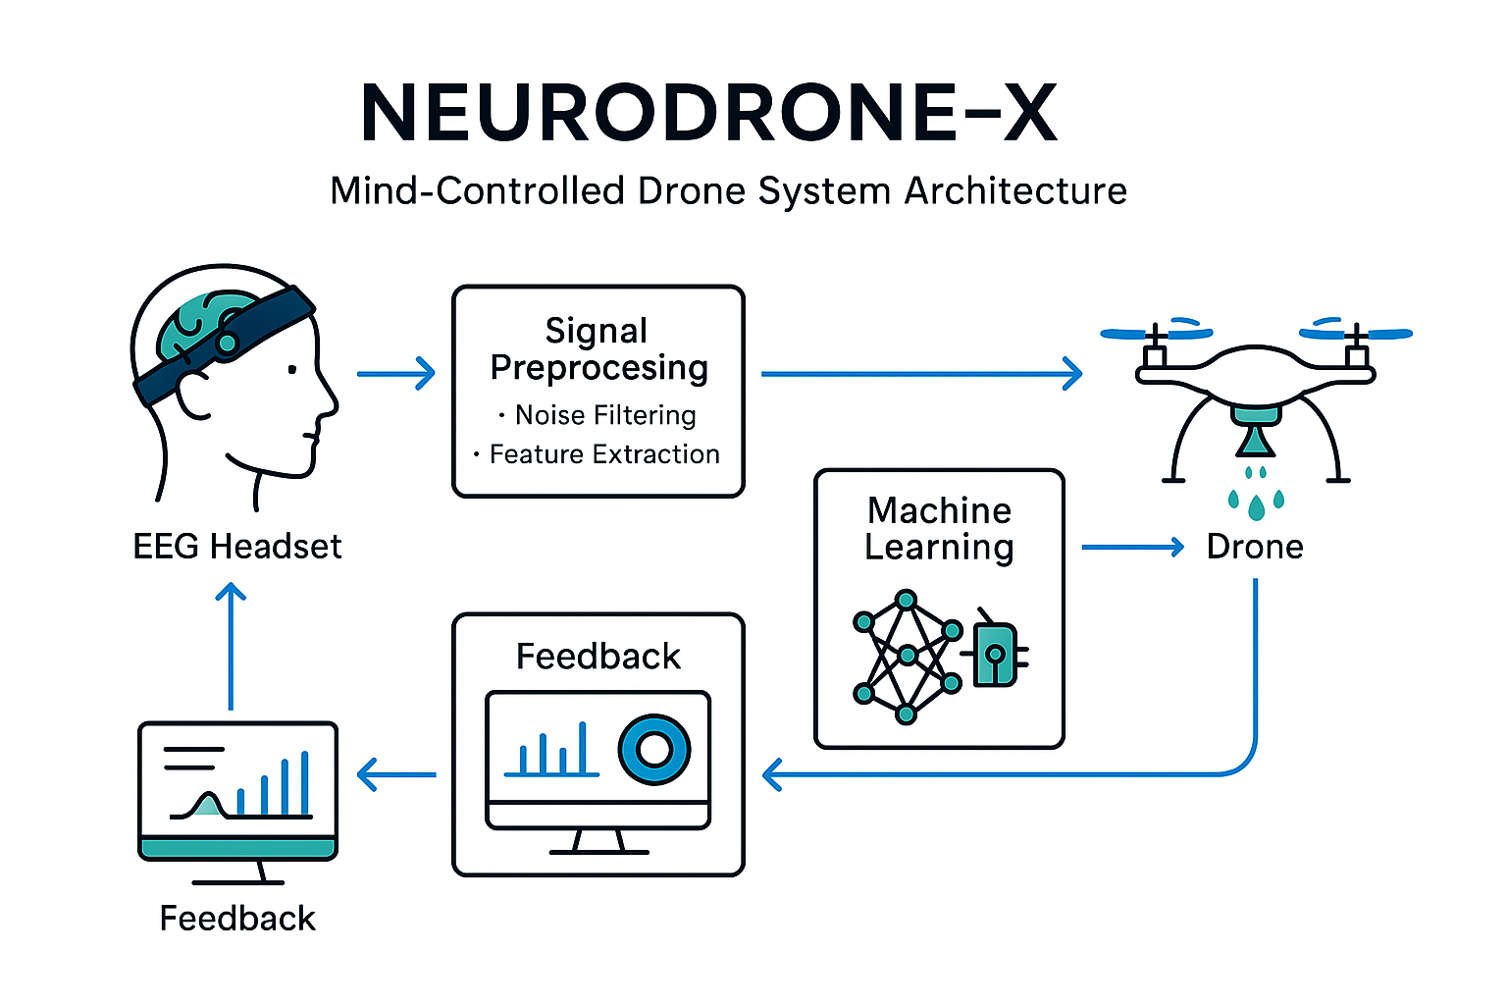
Key Smart Behaviors:
Auto-launch when bin is full
Navigate and align to bin with vision
Pick up and drop waste at disposal zone
Return to base or charger automatically
Follow voice commands like:
“Start soil test”
“Scan the land”
“Check for gases in the air”
Prototype Focus:
Combine multi-role field automation, voice AI, and smart waste handling in one drone unit—test it in real conditions, fail fast, and improve.
🎯 Goal of This System:
Build a functional prototype that proves the drone can respond autonomously to smart bin alerts and farmer voice commands for multi-purpose fieldwork, using advanced AI and sensor tech.

Slide 10
Technical Architecture Diagram Overview:
┌───────────────────────────┐
│ Farmer / Operator │◄── Voice Command (Mic / App)
└───────────────────────────┘
│
▼
┌───────────────────────────┐
│ Neurodrone-X Controller │◄── UI / FastAPI Dashboard
│ - Receives bin alerts │
│ - Parses voice commands │
│ - Sends nav commands │
└───────────────────────────┘
│
▼
┌───────────────────────────┐
│ Drone Brain (Jetson) │
│ - YOLOv8 object detection │
│ - Path planning (ROS) │
│ - Voice NLP (DistilBERT) │
│ - Mission executor │
└───────────────────────────┘
│
▼

Slide 11
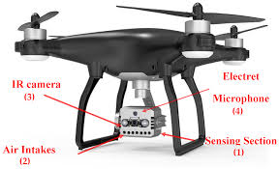
┌───────────────────────────┐
│ Smart Payload (Gripper) │
│ - Grab/drop mechanism │
│ - Controlled by AI model │
└───────────────────────────┘
│
▼
┌───────────────────────────┐
│ Disposal Station │◄── Receives waste from drone
└───────────────────────────┘
Meanwhile...
┌───────────────────────────┐
│ Smart Bin IoT │──► Sends "BIN FULL" signal
│ - ESP32 + ultrasonic │
│ - WiFi / LoRa / MQTT │
└───────────────────────────┘

Slide 12
🧠 Conclusion:
NeuroDrone-X – The Future of Smart Farming & Clean Cities
NeuroDrone-X isn’t just another drone—it’s a self-learning, AI-powered ecosystem that bridges the gap between agriculture and urban waste management. With real-time decision-making, autonomous flight, smart voice controls, and edge AI processing, it empowers farmers and city workers alike to analyze, ideate, and act without tech overhead.
By responding to filled waste bins, performing crop scans, detecting pests, testing soil, and analyzing atmospheric gases—this drone becomes a one-stop solution for smart environments. NeuroDrone-X doesn't just follow commands; it understands purpose.
It’s not science fiction. It’s the next-gen tool for sustainable growth.
THANKYOU

